Slide 1

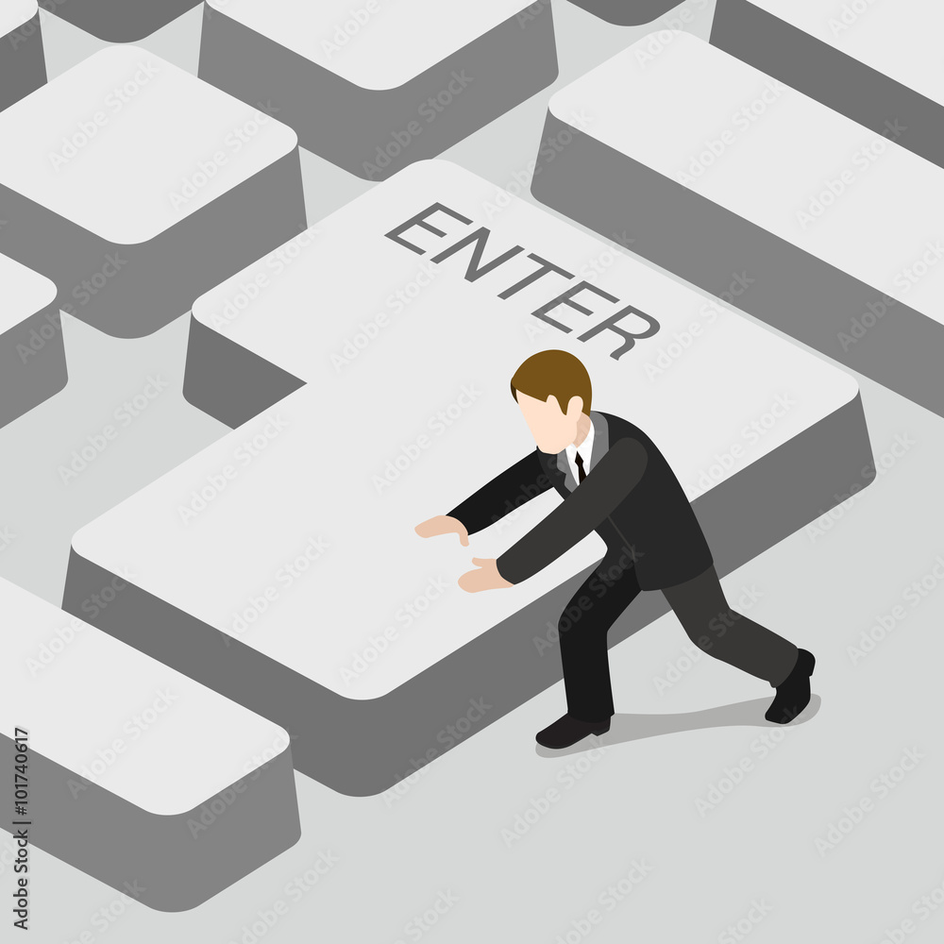

Slide 2


Slide 3


Slide 4




Slide 5
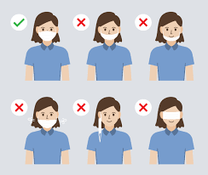
MANDATORY USE OF FACE MASK

Slide 6
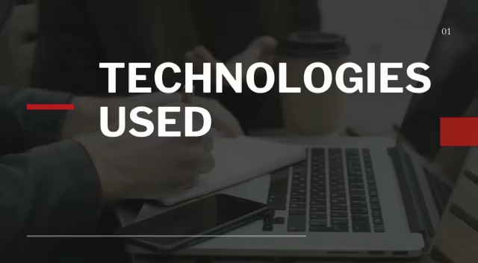

Slide 7
PYTHON OPEN CV
ARTIFICIAL INTELLIGENCE
DEEP LEARNING
MYSQL DATABASE

Slide 8
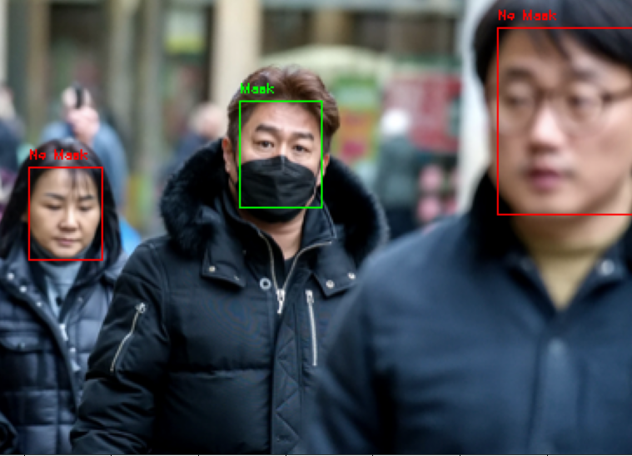
DETECTING FACE MASK IN THE GROUP

Slide 9
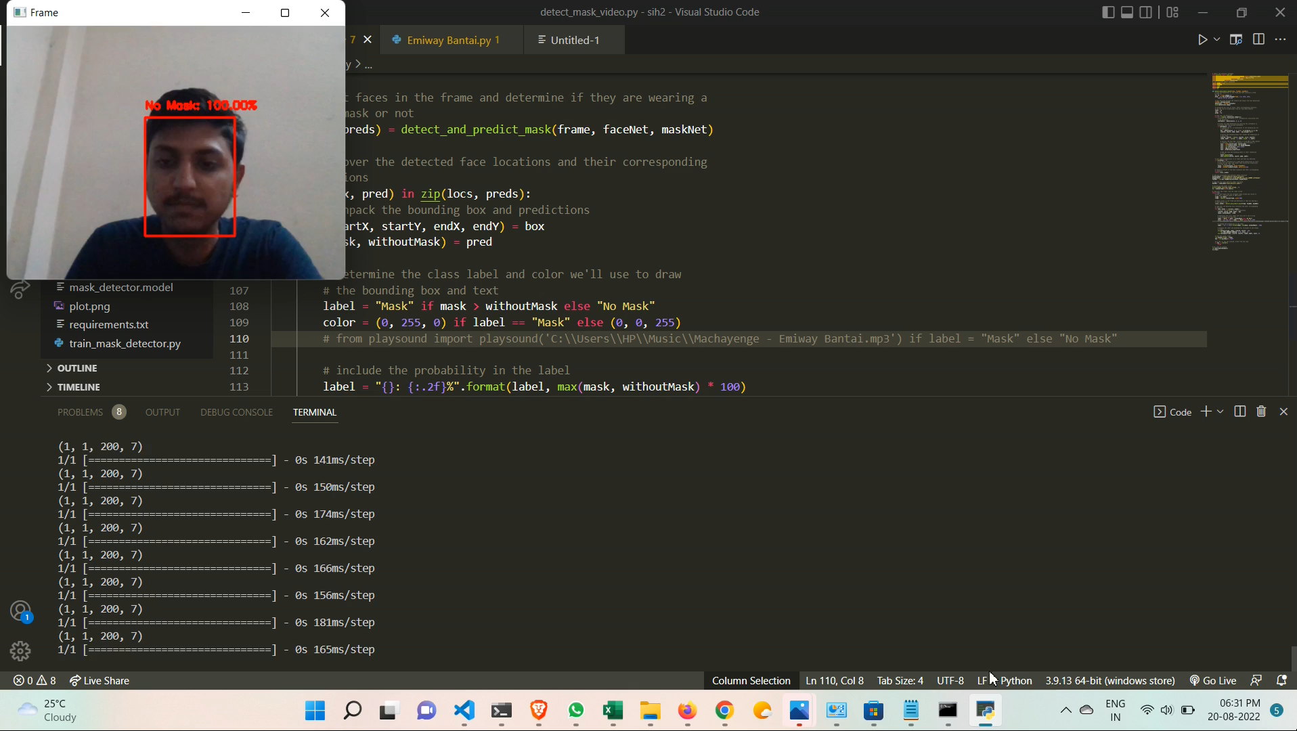

Slide 10
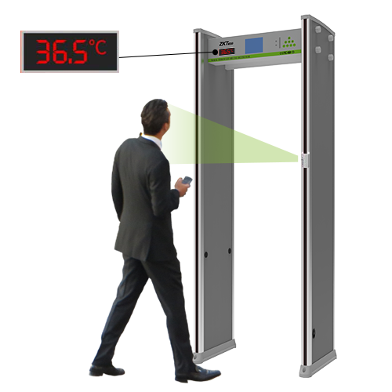
TEMPERATURE SENSING
USING
ARDUINO

Slide 11
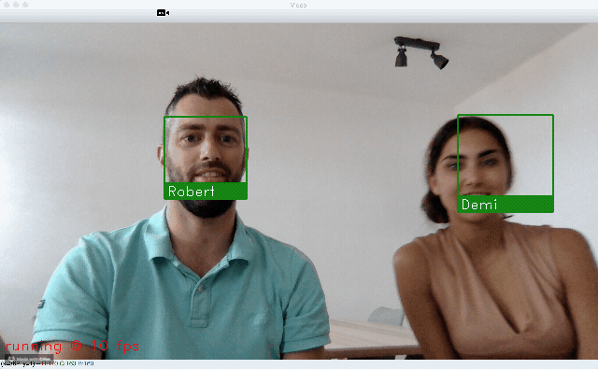
FACE RECOGNITION

Slide 12
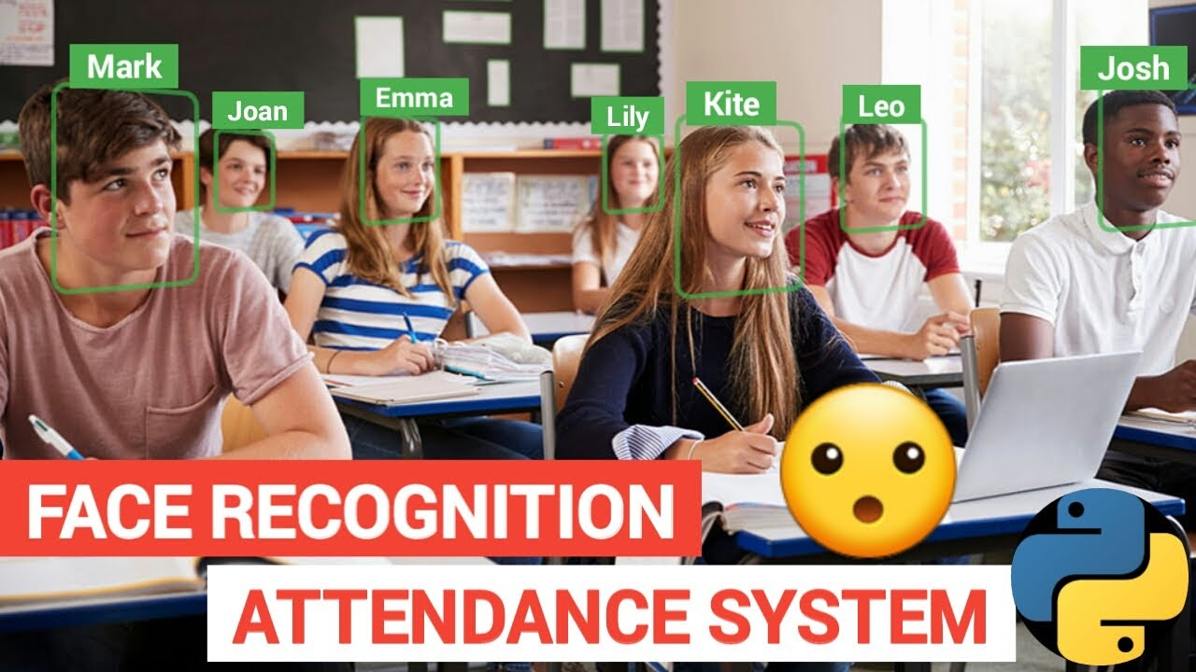
ATTENDANCE MARKED AND RECORDED

Slide 13
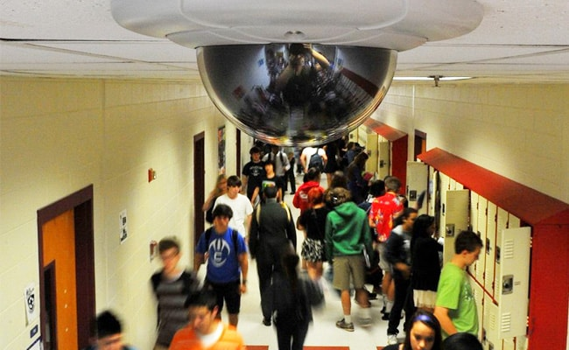
PENALTY CHARGED FOR NOT WEARING MASK PROPERLY

Slide 14

